Slide 1

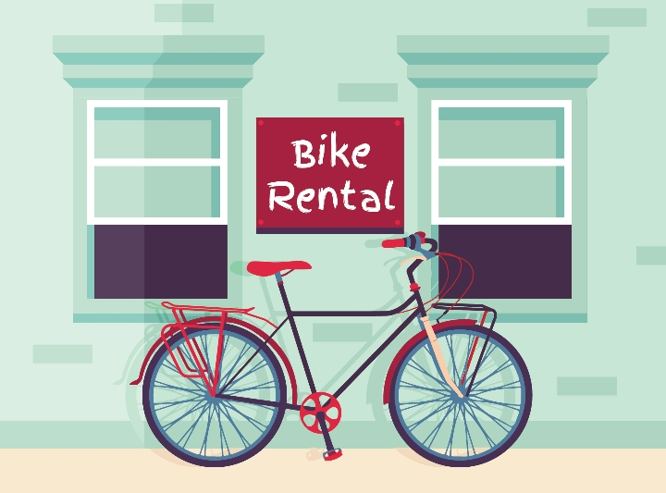
Bicycle rental service "Heroes“ Unlocking Customer Insights
Advisor: Or Cohen Raviv, PhD.

Slide 2
Main objectives:
Deriving main insights from “Heroes” rental bicycle services database.
Identifying the key factors that contribute to lower/higher sales trends, across time
Providing a model to measure the relative contribution of the different key factors.
Providing strategy to boost business growth.
Applied framework: (SWOT: Strength, Weakness, Opportunities and Threats)

Slide 3
"Heroes'” Strength by costumer segments
Hero's’ sales boosted from 2011-2012 across both clients segments:
Sales for registered clients saw an increase of in 66% Casual costumers saw an increase of 50%, from 2011-2012.
(Sample size: registered: 8,645, casual: 8,734, sum of all clients: 17,379)
Year 2011
measure | registered | casual | Total
count | 8645 | 8645 | 8645
mean | 115 | 28 | 143
std | 109 | 38 | 133
min | 0 | 0 | 1
25% | 26 | 3 | 31
50% | 90 | 14 | 109
75% | 168 | 38 | 211
max | 567 | 272 | 651
Year 2012
measure | Registered | casual | Total
count | 8734 | 8734 | 8734
mean | 191 | 42 | 234
std | 175 | 56 | 208
min | 0 | 0 | 1
25% | 46 | 5 | 53
50% | 156 | 20 | 191
75% | 275 | 60 | 347
max | 886 | 367 | 977

Slide 4
"Heroes'” weakness by costumer segments
The Business problem: A drop in sales on several fronts: Costumer type Month Season Holiday Temp. and Humidity

Slide 5
By month

Slide 6
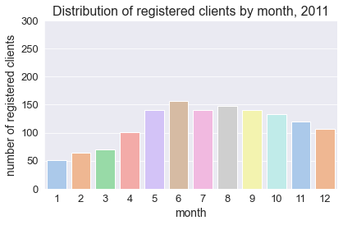
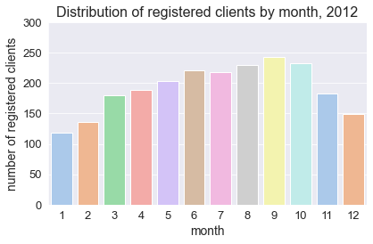
Despite a higher average sales rate for registered clients in 2012, January, February, and November and December are relatively weak sales months. Distribution of registered clients by season for 2011, 2012

Slide 7
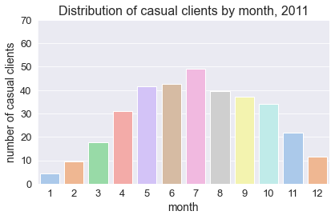
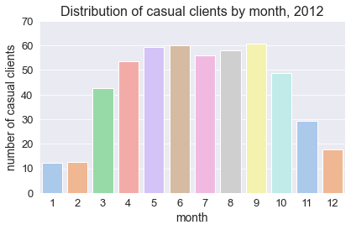
In spite of a higher average sales rate for casual clients in 2012 as opposed to 2011, the same months saw a decline in average sales, as for registered clients.

Slide 8
By season

Slide 9
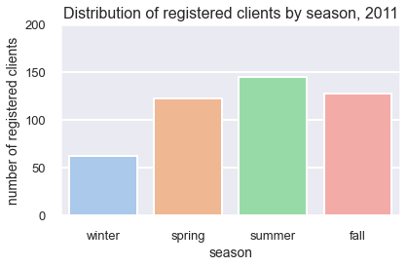
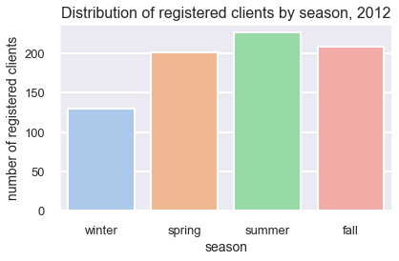
In 2012, the number of registered clients is highest on average in the summer (230) and spring (201), but in the winter, the number of registered clients dropped by nearly half. Registered clients distribution by season for 2011 and 2012

Slide 10
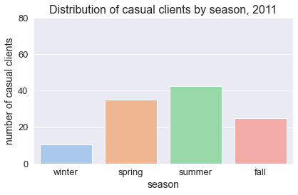
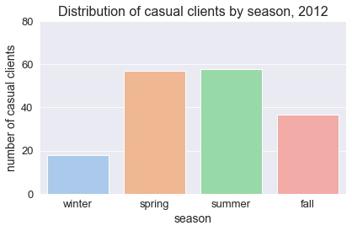
In 2012, the number of casual clients is highest on average in the summer and spring (58 in both), but in the winter, the number of registered clients dropped by nearly half. Casual clients distribution by season for 2011 and 2012

Slide 11
By holiday

Slide 12
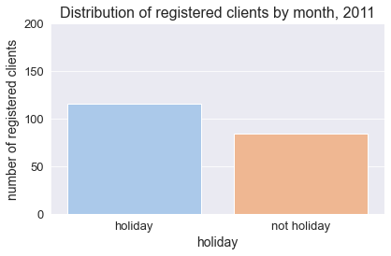
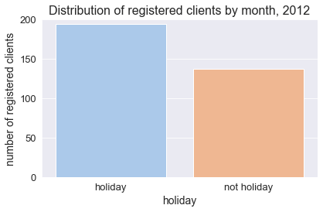
Registered customers are more likely to rent a bike on holiday. This is a surprising finding. It could be that the holiday season serves as a trigger for registration. It could also be that some of the vacations occur in the summer and spring. Registered clients distribution by holiday for 2011 and 2012

Slide 13
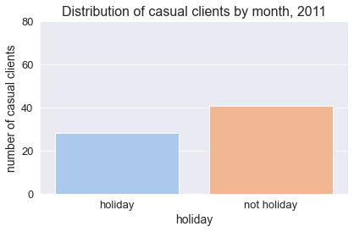
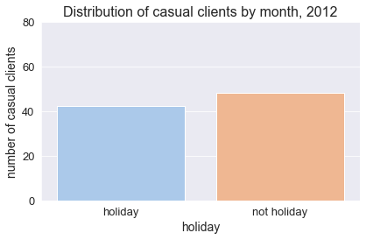
Not on a holiday, casual customers are more likely to rent a bike. Their contact with "Heroes" might be driven by urgent daily needs. Casual clients distribution by holiday for 2011 and 2012

Slide 14
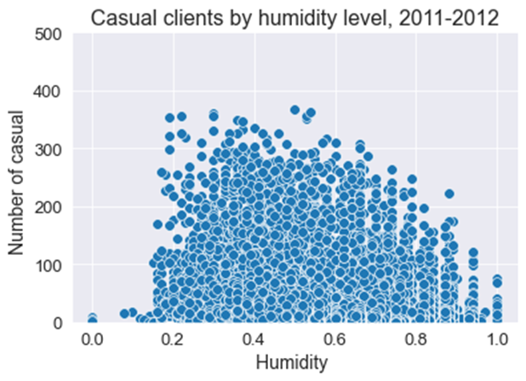
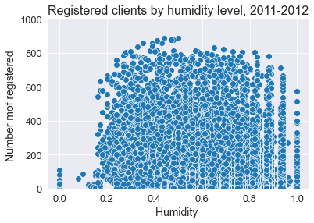
The optimal level of humidity for maximizing register sales is medium. If the humidity is very high or very low, registered customers are less likely to rent a bike. Registered vs. casual clients by humidity level (2011 and 2012)
Registered by humidity level and month, 2011

Slide 15
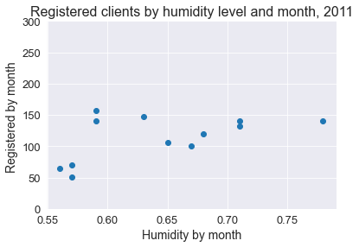
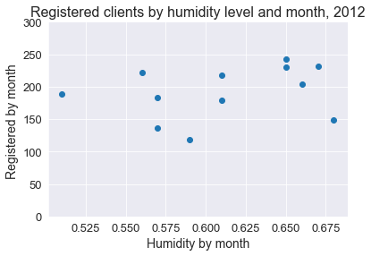
Months with higher/lower level of humidity on average, have lower registers clients on average. Registered by humidity level and month, 2011 and 2012

Slide 16
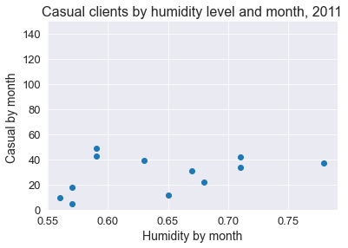
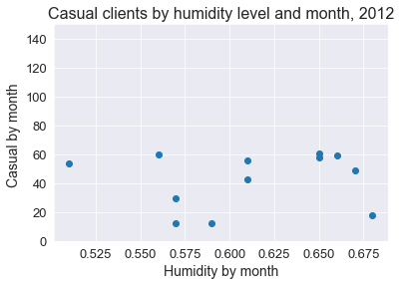
Casual clients by humidity level and month, 2011 and 2012

Slide 17
Model calculation for Hero's key sales contributors, by segment: Both registered and casual clients' sales are strongly and negatively influenced by humidity level (p<0.001) ‘Feeling temperature’ (normalized) has also a strong and positive contribution to explain both registered and casual clients’ sales (p<0.001). Real temperature has a positive contribution to explain casual clients’ sales (p<0.001).
OLS predicting number of registered clients, 2011-2012
Source SS | df | MS Number of obs | = | 17379
 |  |  | F(5, 17373) | 751.67
Model | 70807073 | 5 | 14161414.7 Prob > F | 0
Residual | 3.27E+08 | 17,373 | 18839.9249 R-squared | 0.1779
 |  |  | Adj R-squared | 0.1776
Total | 3.98E+08 | 17,378 | 22909.028 Root MSE | 137.26
registered | Coefficient | Std. err. | P>t t | Beta
weathersit | 4.72 | 1.83 | 2.59 0.010 | 0.020***
temp | 35.31 | 35.70 | 0.99 0.323 | 0.045***
atemp | 245.32 | 40.07 | 6.12 0.000 | 0.279****
hum | -201.82 | 6.31 | -31.98 0.000 | --0.257***
windspeed | 31.63 | 9.26 | 3.42 0.001 | 0.026
_cons | 133.3671 | 5.760002 | 23.15 0.000 | .
OLS predicting number of casual clients, 2011-2012
Source | SS | df | MS Number of obs | 17,379
 |  |  | F(5, 17373) | 1584.91
Model | 13233592 | 5 | 2646718.47 Prob > F | 0
Residual | 29012083 | 17,373 | 1669.95238 R-squared | 0.3133
 |  |  | Adj R-squared | 0.3131
Total | 42245675 | 17,378 | 2430.98602 Root MSE | 40.865
casual | Coefficient | Std. err. | P>t t | Beta
weathersit | 2.40 | 0.54 | 4.41 0.000 | 0.031***
temp | 45.93 | 10.63 | 4.32 0.000 | 0.179***
atemp | 75.74 | 11.93 | 6.35 0.000 | 0.264***
hum | -84.23 | 1.88 | -44.83 0.000 | --0.330***
windspeed | 5.83 | 2.76 | 2.11 0.035 | 0.014
_cons | 25.12159 | 1.714885 | 14.65 0.000 | .

Slide 18
Conclusions and recommendations for leveraging Heroes’ sales
"Heroes" has seen an increase in sales among casual clients and a dramatic increase among registered clients between 2011 and 2012.
However, a decline in sales has been observed during the winter and fall months (January, February, November, and December), as well as on non-holiday dates for registered users, due to high/low humidity levels.
Recommendations for boosting Heroes’ sales
) It is recommended that "Heroes" implement promotions such as discounts on bike rentals during the winter and fall for both registered and casual clients, ‘bike+ free coffee’ (Partnering with local coffee shops and cafes).
Offering an incentive package, such as a bike rental with a complimentary swimming pool entrance, during high humidity periods can further boost sales.
Targeted advertising efforts towards registered users prior to holidays can also drive increased rentals.
Creating special events such as bike tours, races, and picnics during the low season to attract more clients.
Providing additional services such as bike maintenance, storage, and repair to retain clients and increase customer loyalty, specifically among casual clients.
Developing strategic alliances with complementary businesses, such as sports shops, to cross-promote each other's services.

